Slide 1

The principles of
animation
Tutor : Liyan Chen
Email: chenliyan@xmu.edu.cn

Slide 2
Chapter 7
Character Expression Animation

Slide 3
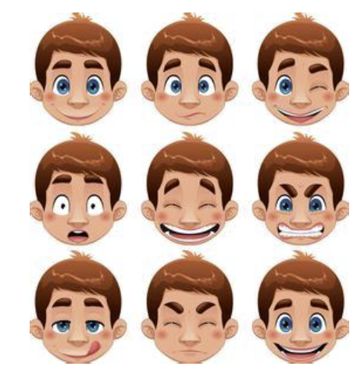

Slide 4
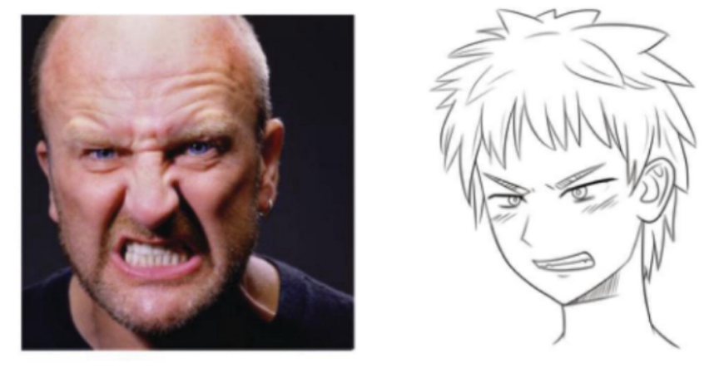

Slide 5

Small expressions on circles
1.1 Normal expression
.
Simple things tend to get to the heart of the matter, whether they are people or animals, and expressions that we can usually recognize can be abstracted to a circle of the face.

Slide 6
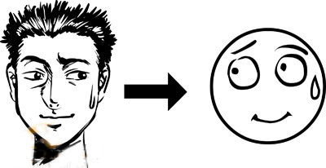
A character’s expression can be abstracted as an expression on a circle.

Slide 7

Common expressions

Slide 8
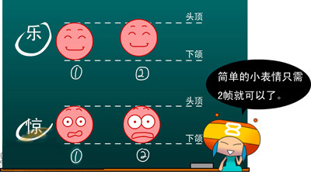

Slide 9
1.2 Use the circle face to create an exaggerated expression
Animation is an art, it comes from life, but must be higher than life. It is not enough just to make the expression exactly the same as the life, it can not show the character of the animation. In order to achieve a more impressive and vivid effect, the expression needs to be exaggerated and enhanced. Want to do more “Animation”of the expression, the same principle as before, but we can go a little deeper: the same “Fun”and “Surprised”, it made it more than 3 frames of animation.

Slide 10
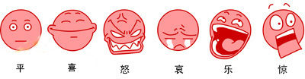
Exaggerated expressions of joy, anger, sorrow and joy

Slide 11
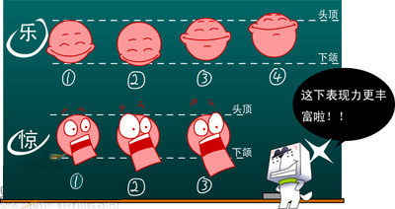

Slide 12
2. Replace the circle with a more detailed, lovely face
In this step, the same principles of animation described in the previous section apply. Of course, in order to draw exaggerated facial expressions, in addition to understanding the law of expression, but also to add some of the character’s character and the character of the habitual action.

Slide 13
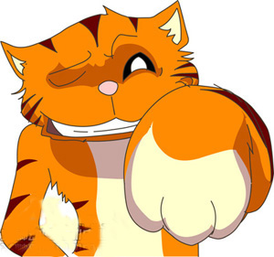


Slide 14
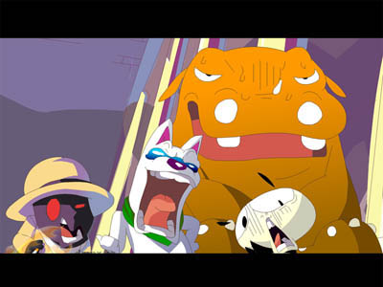

Slide 15
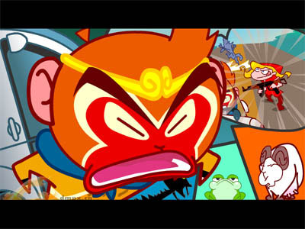

Slide 16
3. Switch between small expressions
Isolated expressions are not enough. We are happy in one moment and sad in the next. This involves a transition from one state of expression to another.

Slide 17

Take the transition from “Joy” to “Sorrow”,
then to “sad”

Slide 18
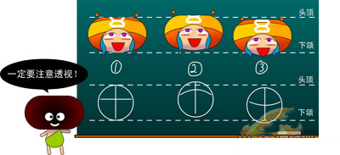

Slide 19
The switch of expression
We need to fill in the gaps between “Joy”and “Surprise”, that is, fill in the middle between them, so that the animation looks smoother. So, here we have to pay attention to a basic principle of animation, which is called “Preparation and residue.”.

Slide 20


Slide 21


Slide 22


Slide 23
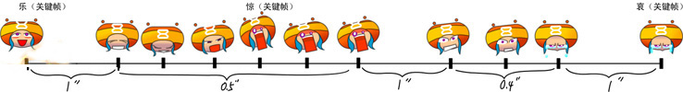

Slide 24
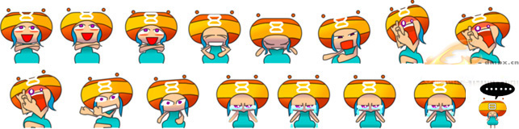

Slide 25
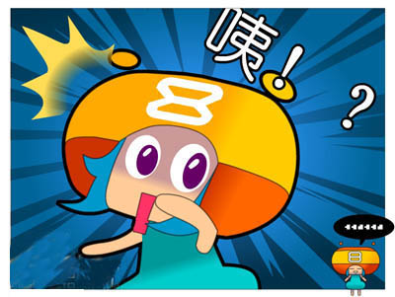


Slide 26
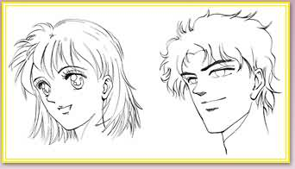
4, the characteristic and drawing method of the typical expression
(1) smiling face

Slide 27
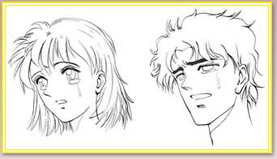
(2) crying

Slide 28
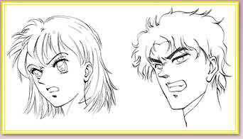
(3) Anger

Slide 29
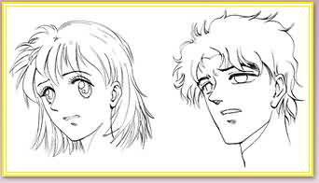
(4) Sad

Slide 30
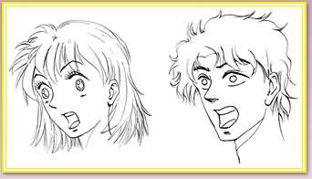
(5) Surprised

Slide 31
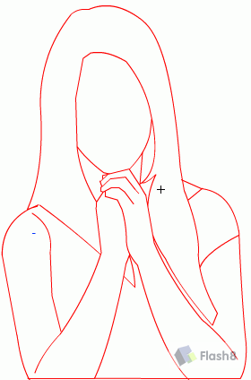
4, How to draw character in An

Slide 32
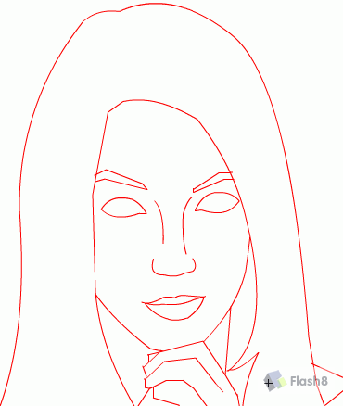

Slide 33
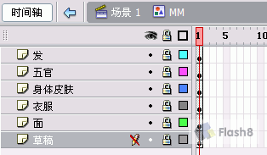
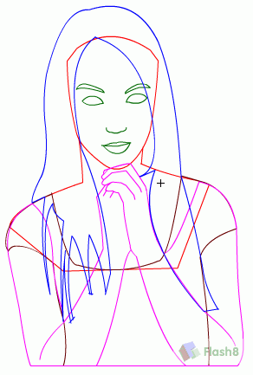

Slide 34


Slide 35


Slide 36


Slide 38


Slide 39


Slide 40


Slide 41


Slide 42


